Slide 1
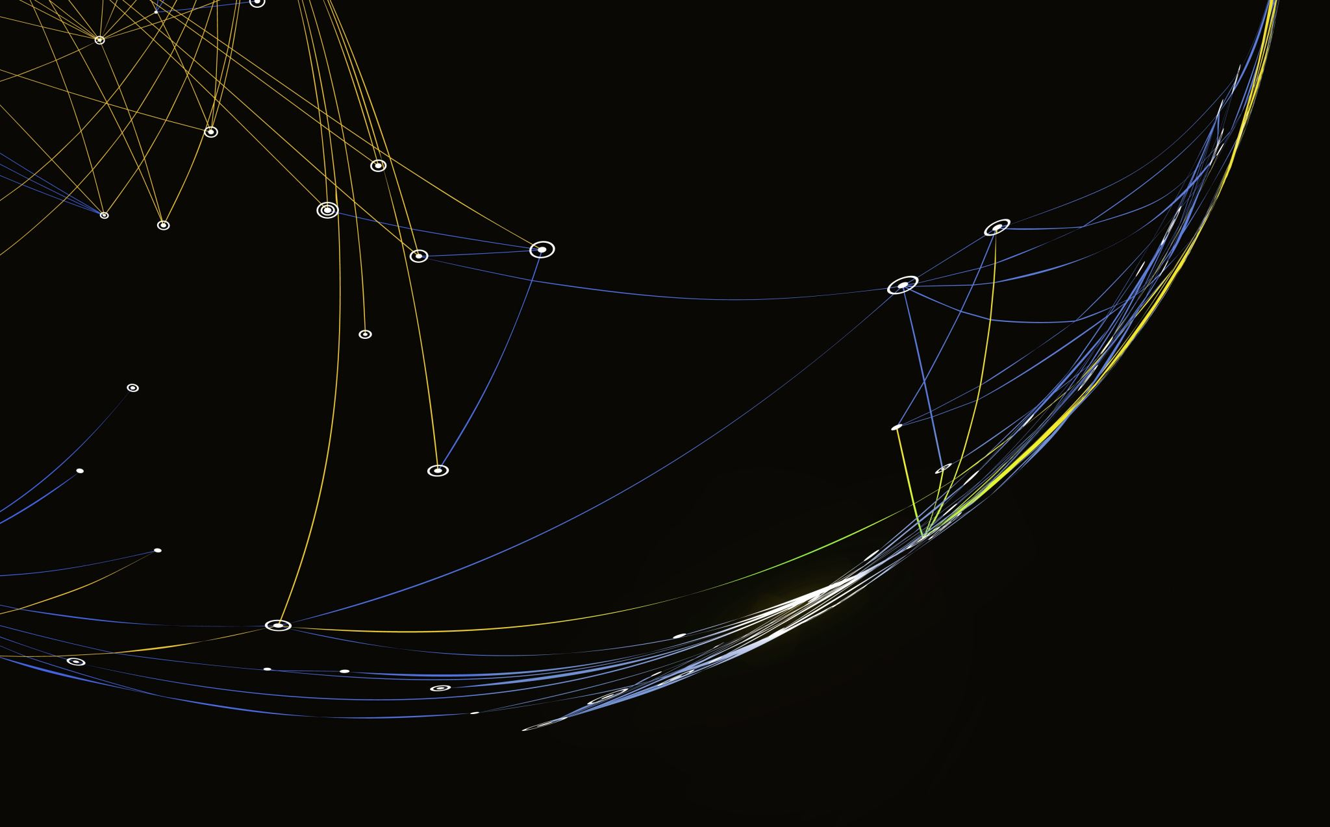
Potion Slayer

Slide 2
Game Concept
You are playing as an alchemist, fighting monsters with your potions
Draw ~5 ingredients from your backpack, brew a potion using them
Each potion has different effects (offensive/defensive)
Each monster has different attack speed (for instance the weakest monster can have 1 attack every 10 seconds)
Beat the monster to progress to restock phase
In restock phase you can take new or replace existing ingredient
If monster beats you – you lose

Slide 3
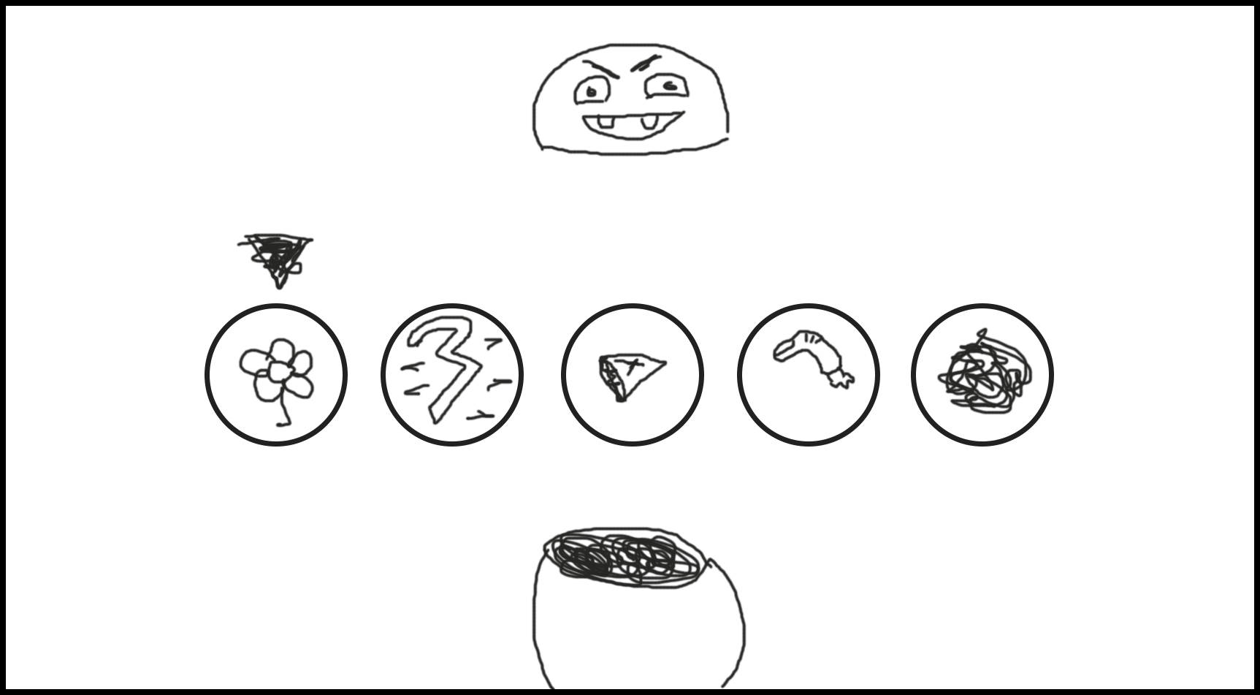
Concept Art

Slide 4
Features
Battle System
Brewing System
Upgrade System

Slide 5
Pillars
1. Brewing Potions [50%]:
asdas
Brew potions to fight against monsters, choose between offensive and defensive potions depending on the situation.
Manage Ingredients [30%]:
Choose ingredients that you draw from your backpack to brew potions, if you will miss the recipe there will be consequences
3. Restock [20%]:
Change ingredients or pick new ones

Slide 6
Skills Students will Use
Classes (ingredients, enemies, recipes…)
Arrays (ingredients in backpack, ingredients in hand..)
Graphics (sprites, animations..)
Source control (github and git)
Software (VS2022, photoshop/aseprite, fl studio/audacity..)
Teamwork
Documentation (concept doc, design doc..)

Slide 7
Fun Elements
Freedom of crafting different potions, so you can implement dozens of them
Different enemies that make player adjust to them
Art style is completely up to the developers

Slide 8
Elements
Visual Asset Creation [15]
Draw enemy sprites, icons for ingredients, cauldron sprite with “puff” animation and background.
Audio Asset Creation [5]
Sounds of potion mixing, enemy growls and UI sounds.
Menu System [5]
Basic text-based menu using SFML font, navigable with arrow keys and spacebar.
HUD [10]
Simple text or bar visuals for player and enemy HP updated in real-time.

Slide 9
Elements
Basic Gameplay [20]
Use arrow keys to highlight ingredients, spacebar to mix. Simple timer using SFML clock to invoke enemy attacks.
Graphics [20]
Load and manage sprites and animations for ingredients, enemies, and text for HP using SFML.
Advanced Gameplay [15]
Simple if-statements to switch enemies, increasing HP and adjusting attack speed.
Advanced Graphics [10]
Simple sprite tint or overlay animation when enemy attacks. Basic color change logic for HP bars using SFML graphics.

